Slide 1

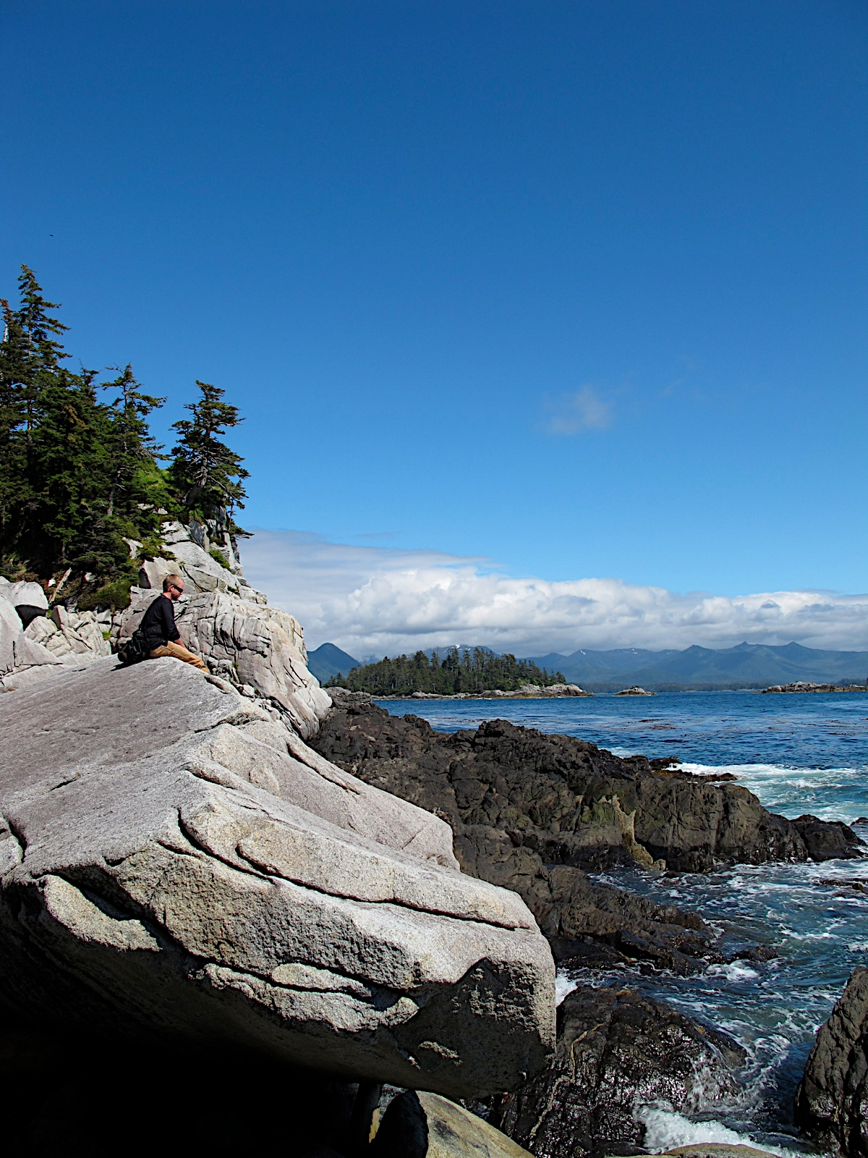

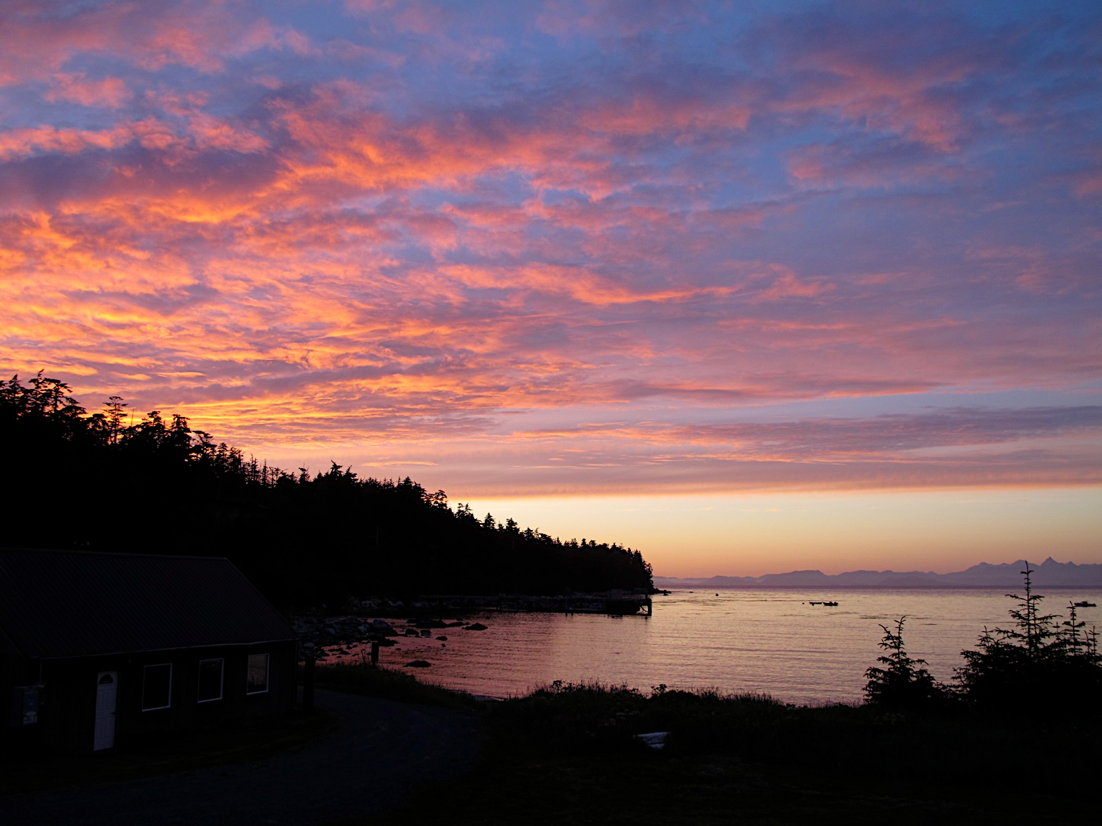
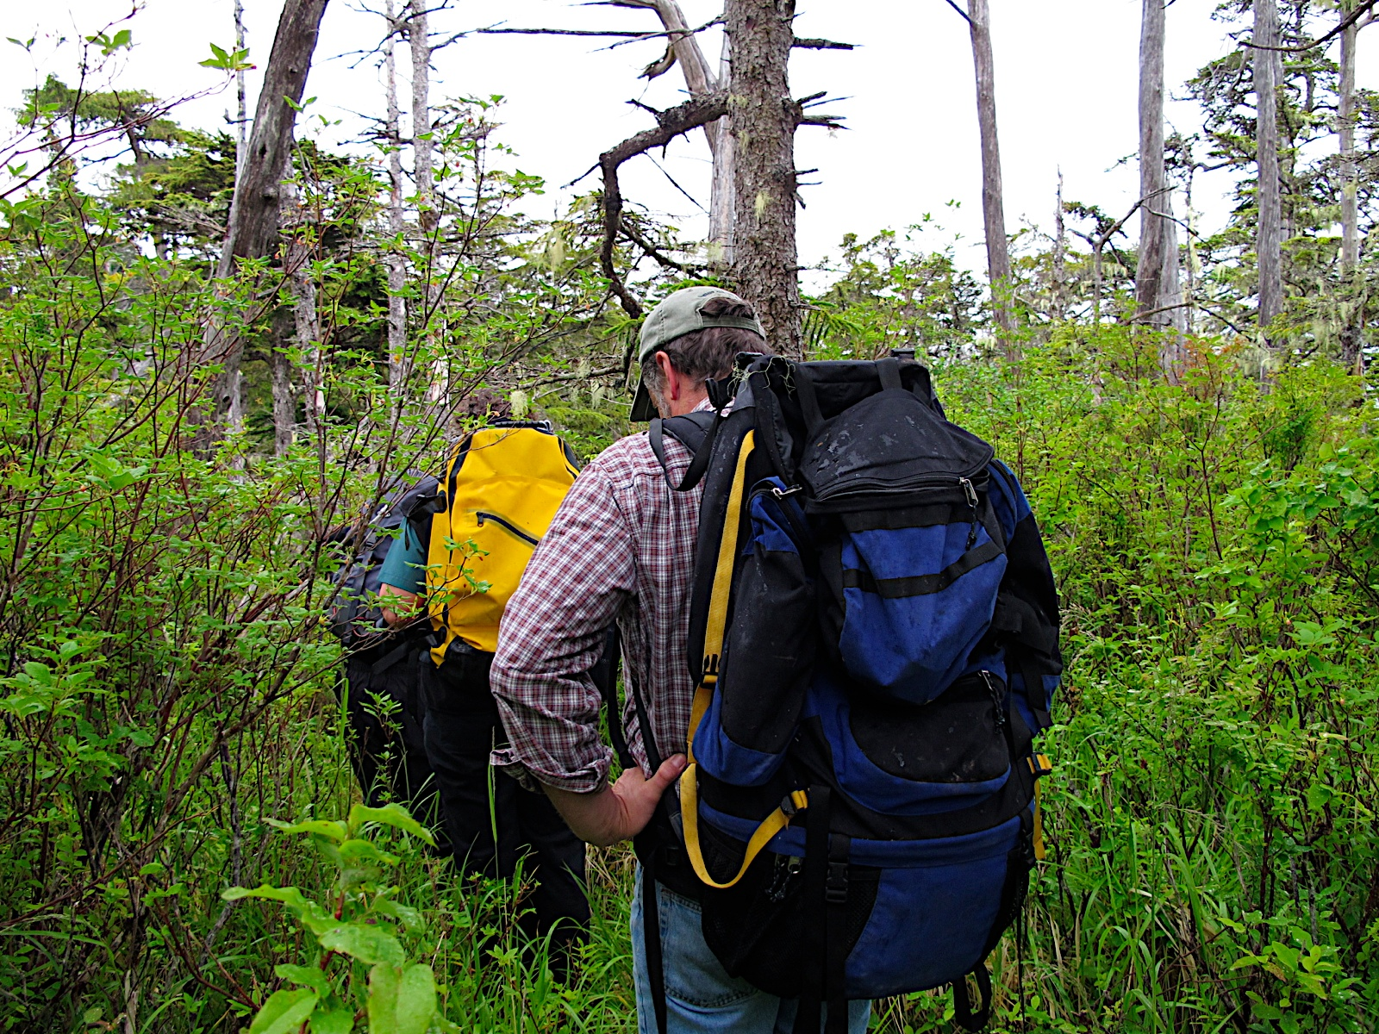
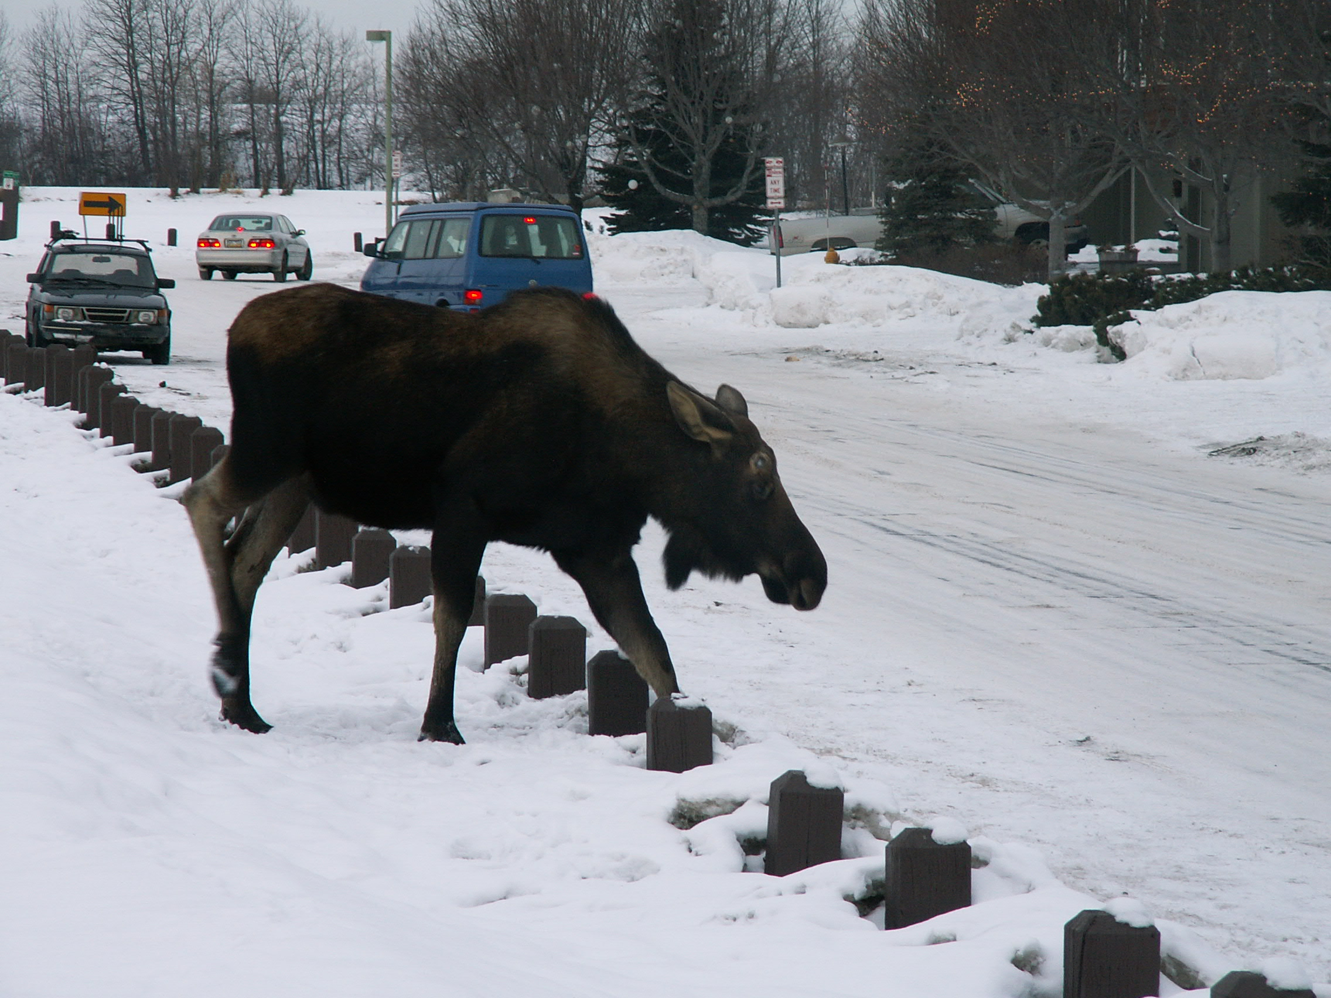
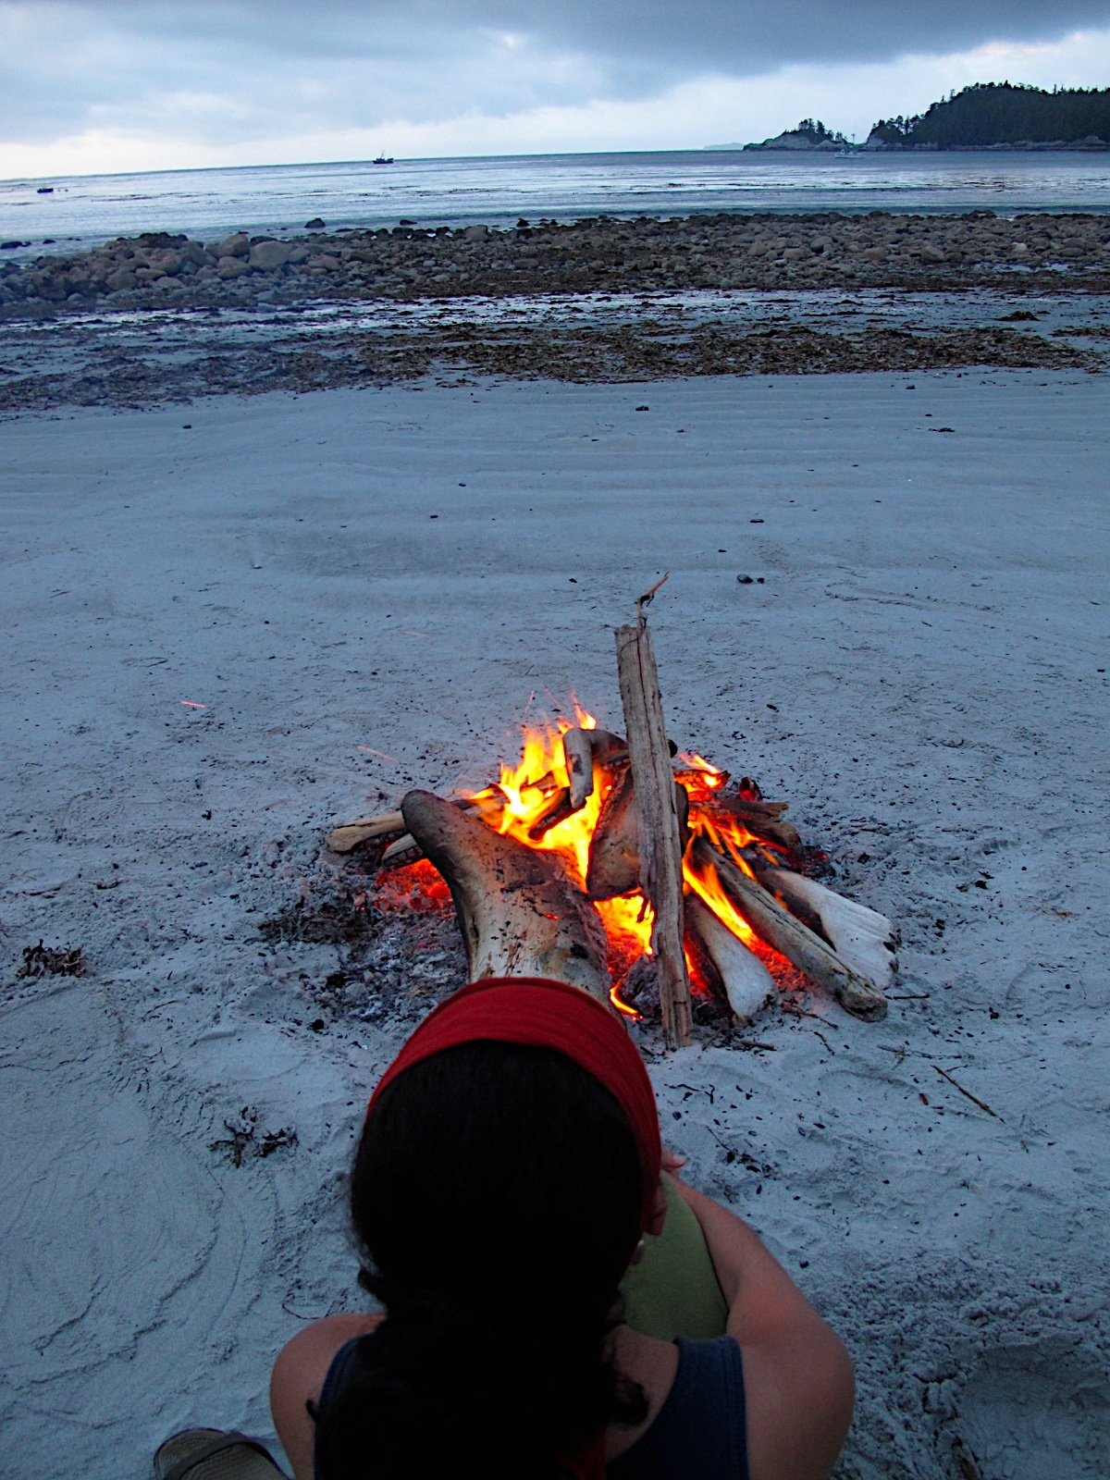
Internship Open House
October 28, 2013, 9am to 4pm (Lunch Provided)
Alaska Mental Health Trust Building, Anchorage, AK
RSVP required- email sarah.dewane@providence.org
Mission and Purpose
Training Structure
The Alaska Psychology Internship Consortium’s (AK-PIC) mission is to prepare and retain psychologists to provide culturally competent collaborative health care for Alaska’s unique and diverse people.
AK-PIC represents the collaborative effort of five Alaska agencies to share resources and faculty for the purpose of providing a diversified educational program for doctoral psychology interns. The consortium was designed to prepare interns to meet the unique challenges of practicing psychology in rural and remote settings and to ensure clinical competency in working with Alaska’s various cultural groups.
The Consortium offers one-year, full-time internships beginning and ending in July each year. The Consortium is comprised of treatment centers throughout Alaska and will provide a range of clinical and didactic experiences. Interns have a primary placement at one site, and complete mini-rotations at other sites within the consortium.
All consortium sites include the following 3 major training emphases:
Psychotherapy, Assessment, Addictions Treatment
All interns will also complete the following:
1 week Adventure-Based Orientation in remote setting
1 week Inpatient Rotation at the Alaska Psychiatric Institute
1 week Village Rotation at the Norton Sound Health Corporation
1 week Transcultural Medicine Rotation at Providence Hospital
Accreditation Status
Training Sites
AK-PIC is accredited by the American Psychological Association
AK-PIC is also an APPIC-member internship program
Alaska Family Medicine Residency, Providence Hospital
Alaska Psychiatric Institute (API)
Hope Counseling Center
Norton Sound Health Corporation- Behavioral Health Services
SouthEast Alaska Regional Health Consortium (inactive for 2014)
Experience New Cultures
Travel Across Alaska
Broaden Your Training
For more information about AK-PIC:
www.ak-pic.org
Supported by the Western Interstate Commission for Higher Education, the Alaska Mental Health Trust Authority, and the Division of Behavioral Health Alaska Department of Health and Social Services

Slide 2
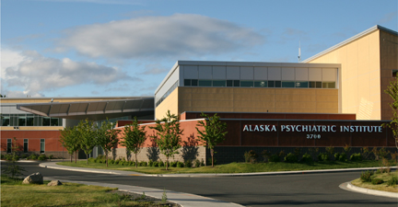
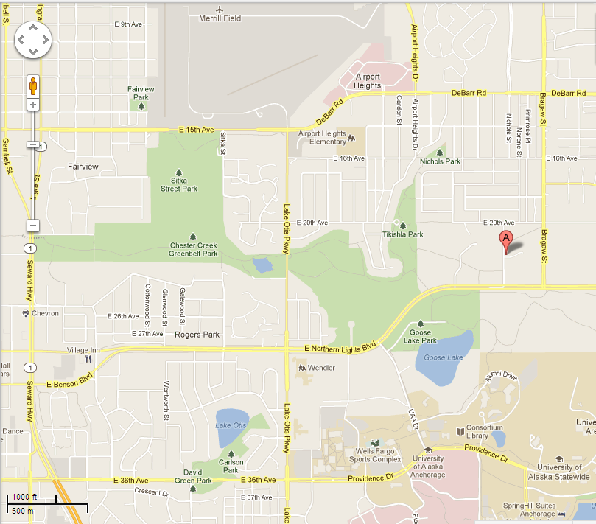
Location: Alaska Mental Health Trust Building Main Conference Room, 1st Floor 3745 Community Park Loop Suite 200, Anchorage AK 99508 (Tel: 907-269-7960

